Slide 1
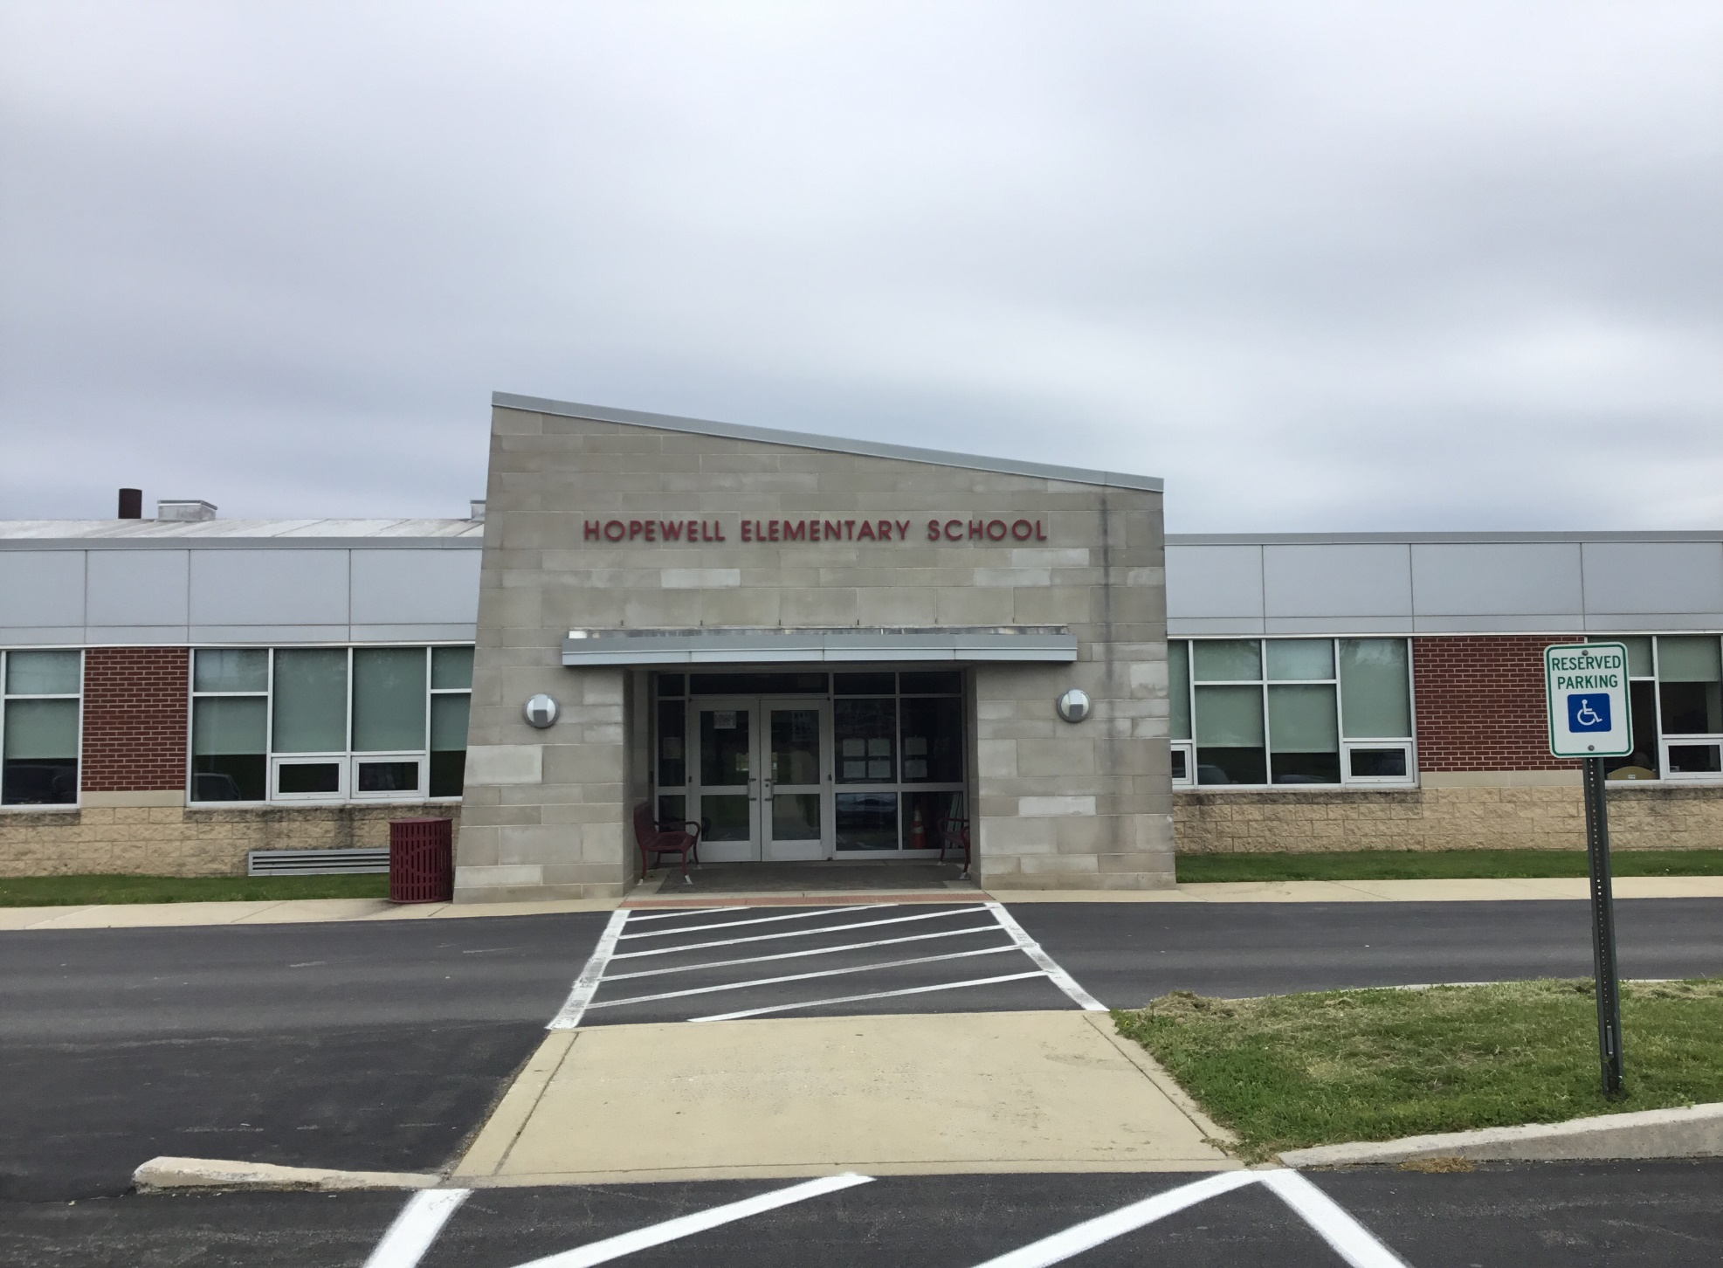
Hopewell Elementary

Slide 2
Dr. Addis- Building Principal

Slide 3
Welcome to Hopewell soon to be 5th grade students!
We think you’re going to like it here too!

Slide 4
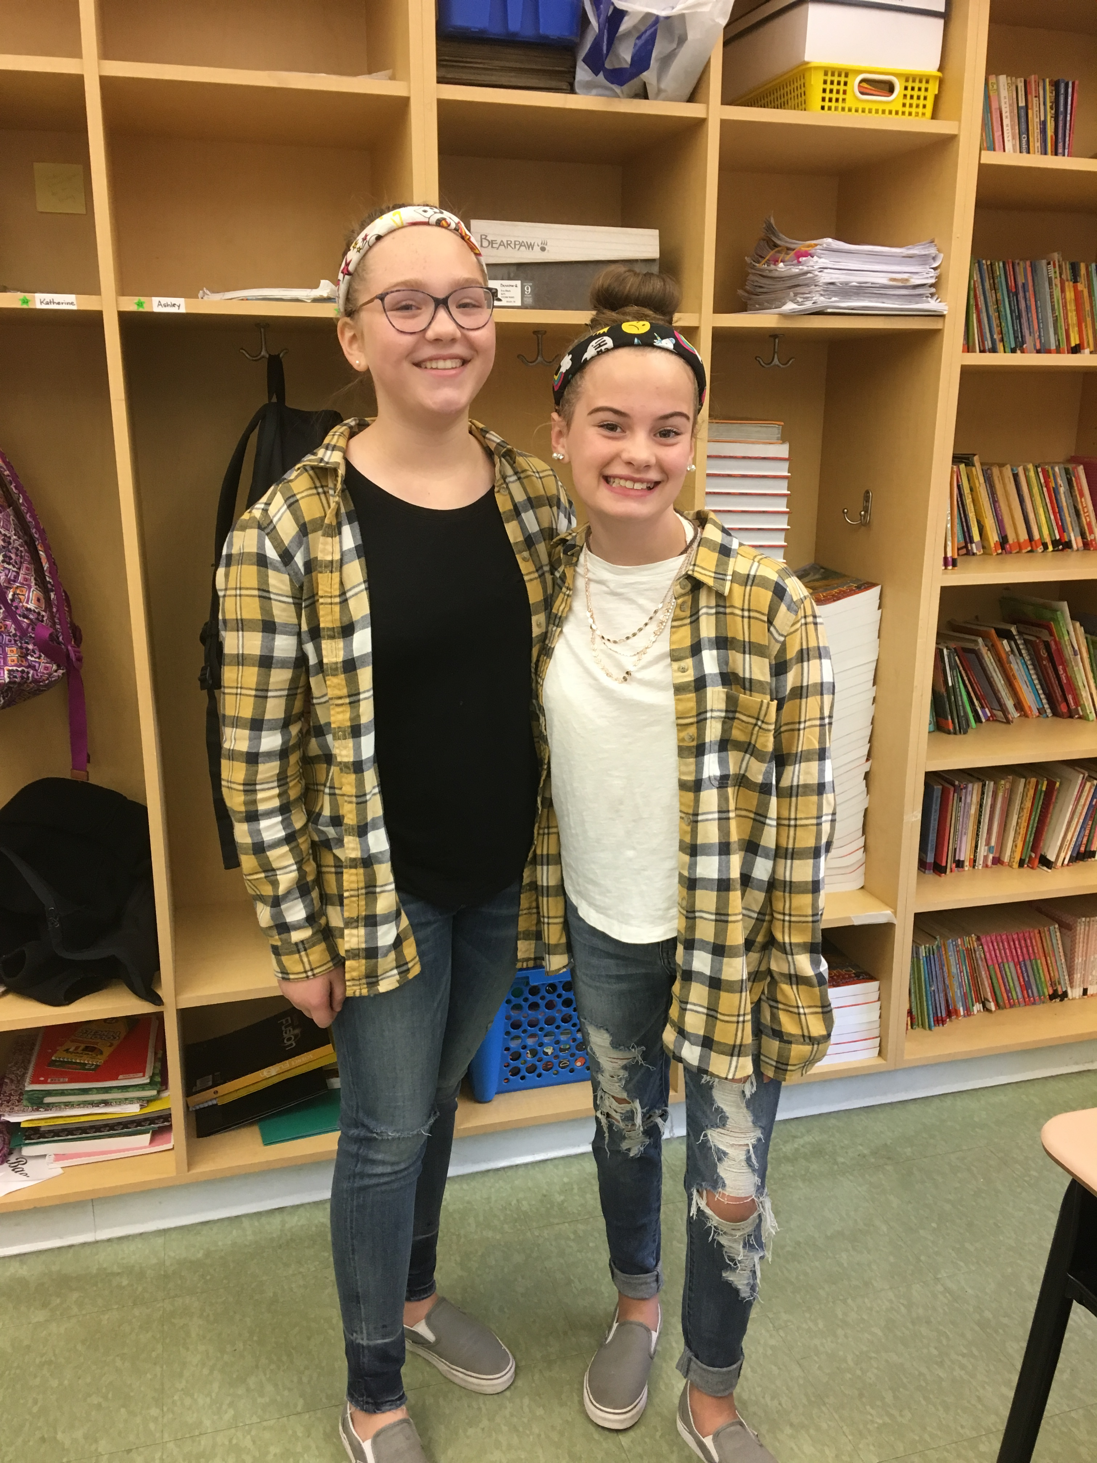
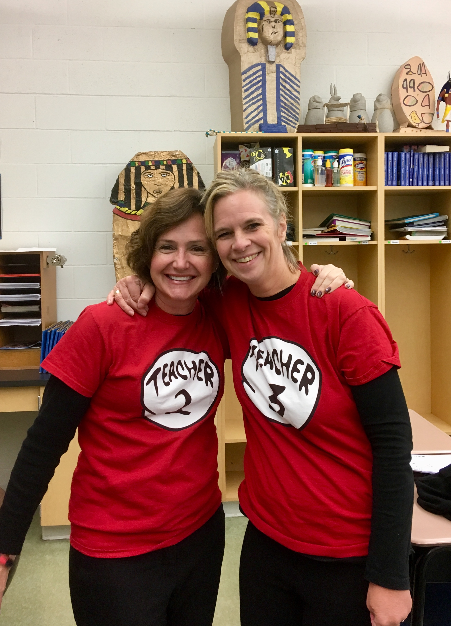
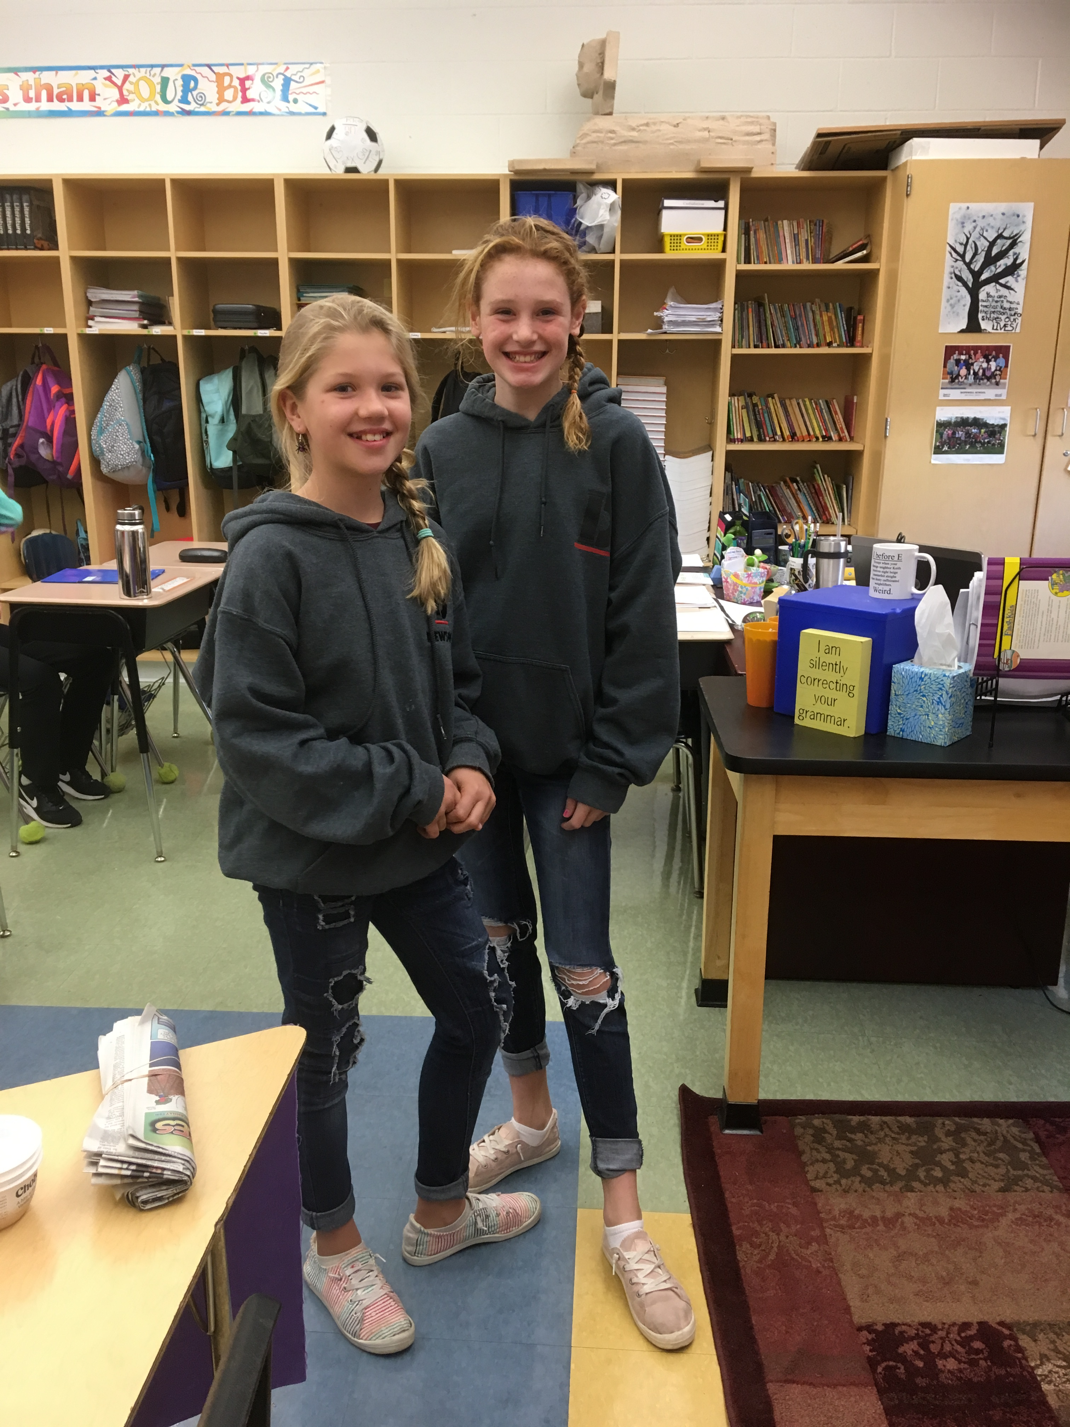
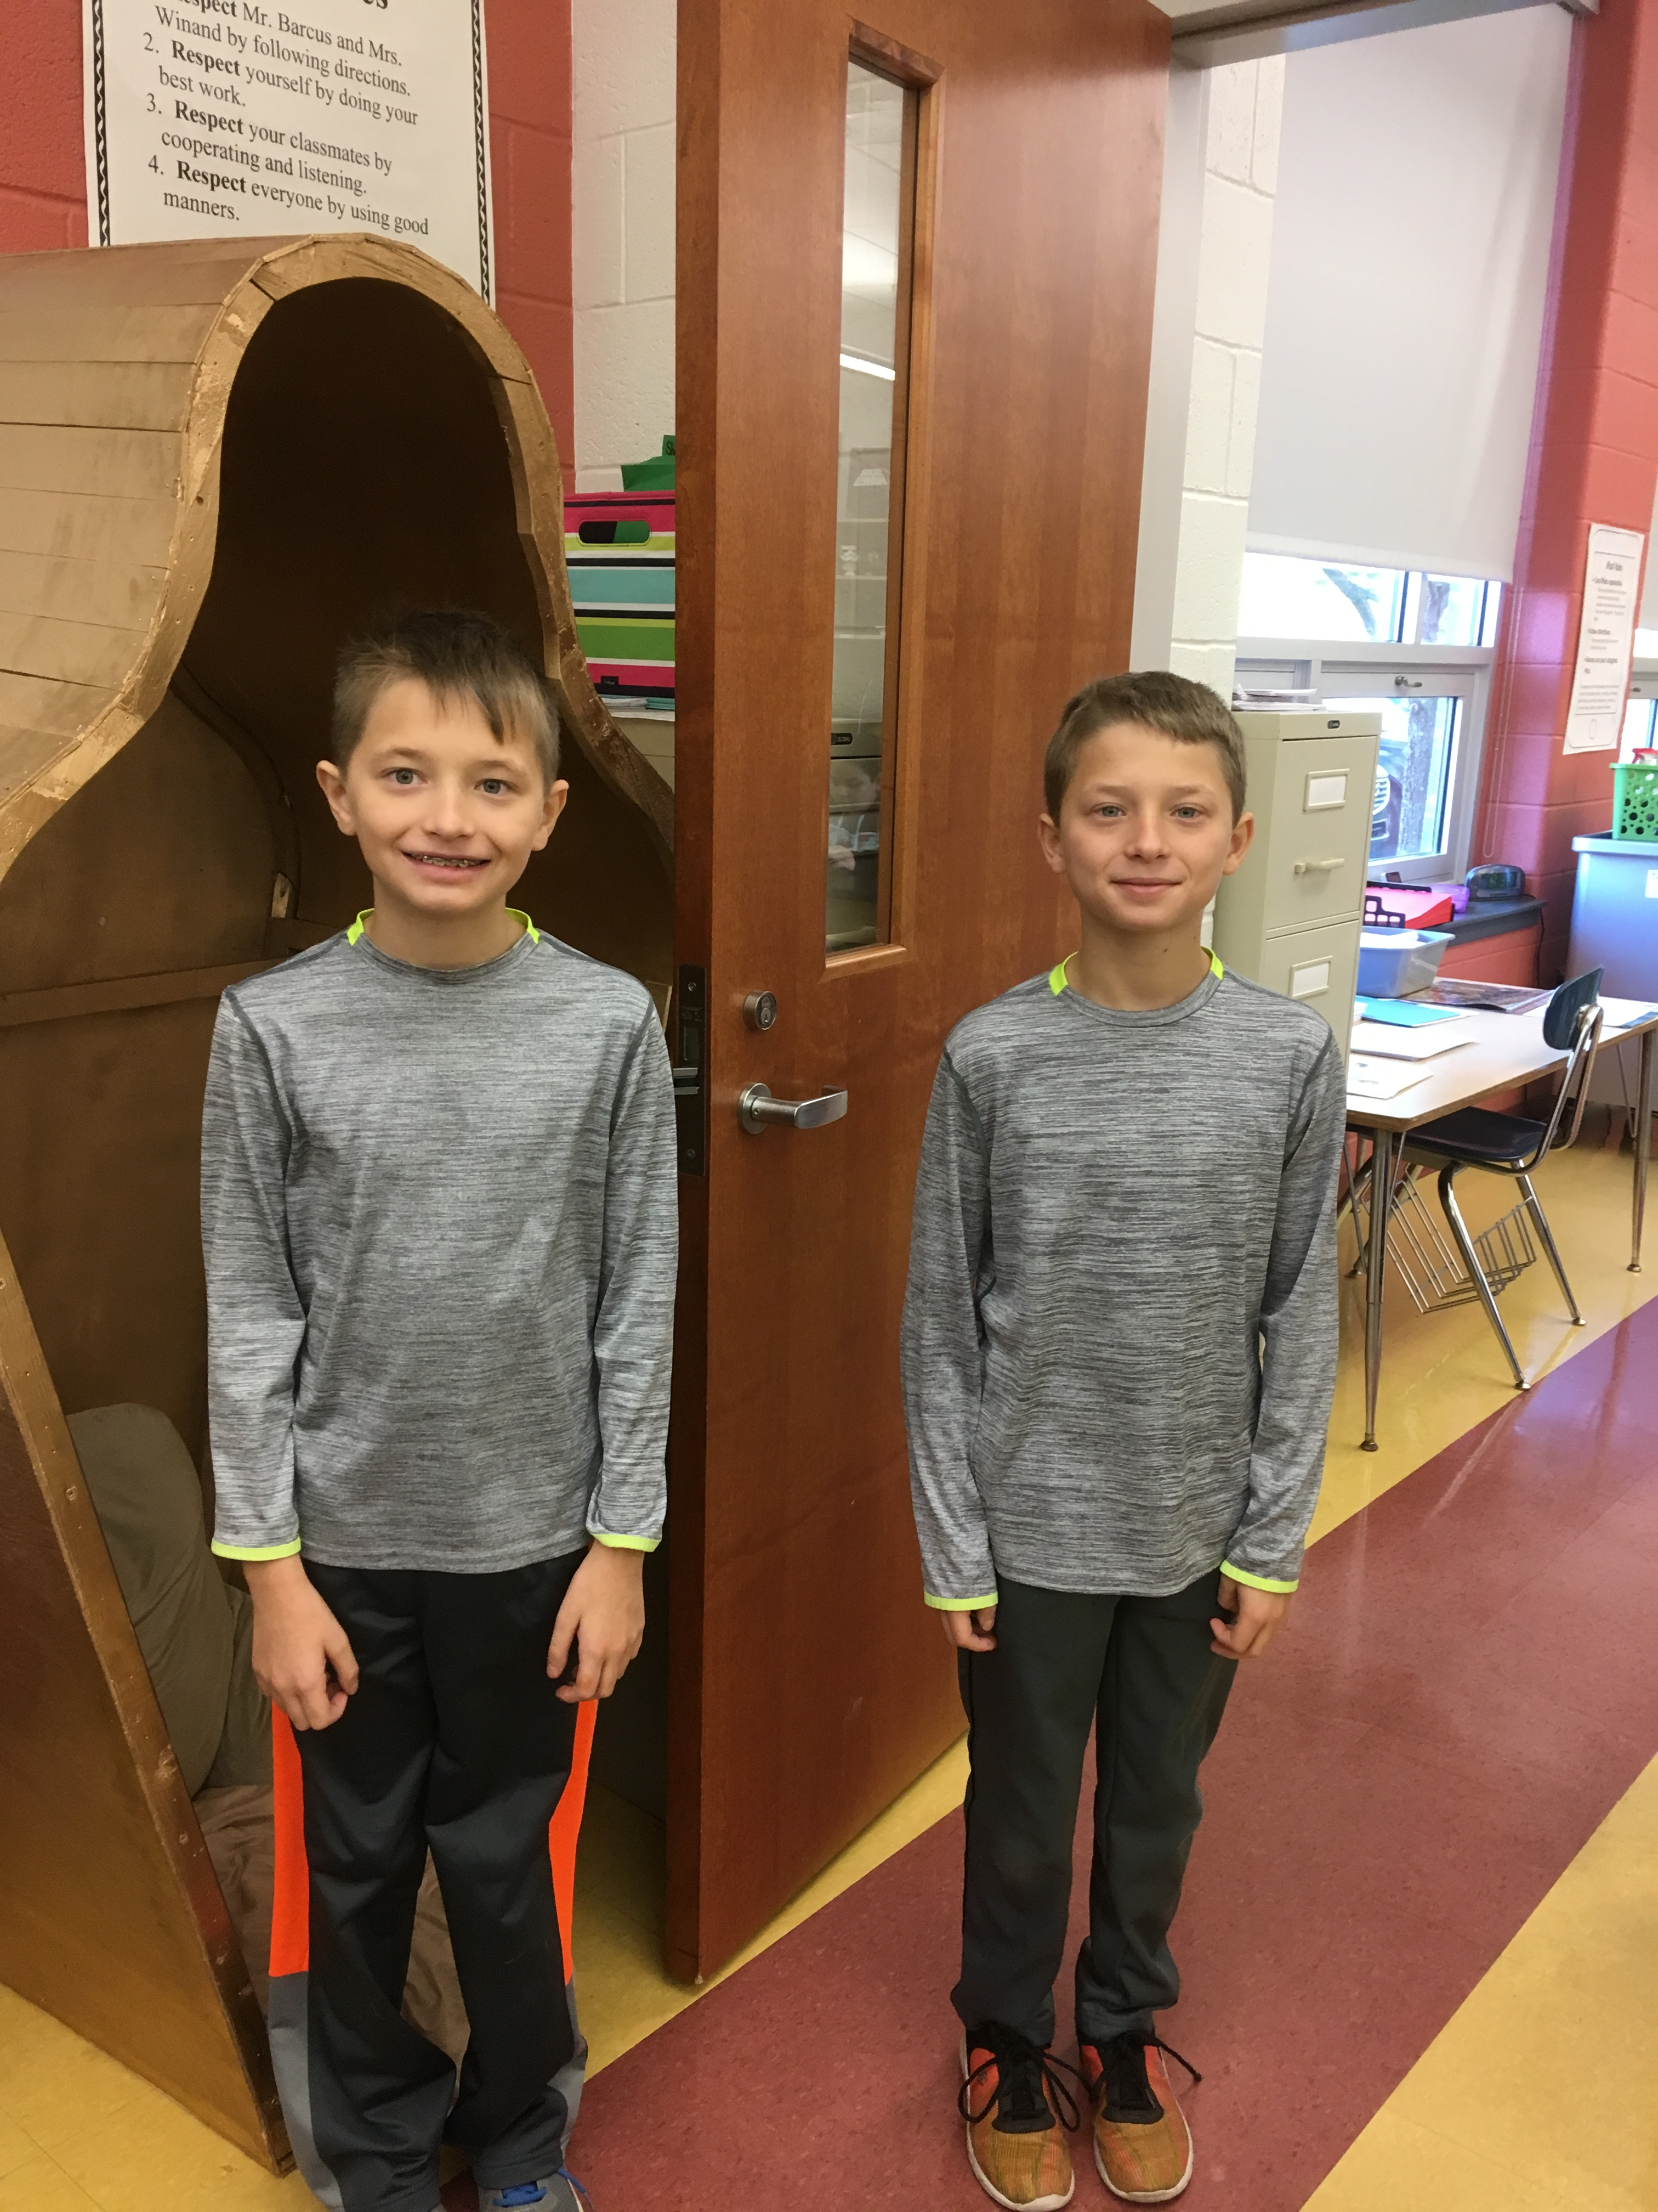
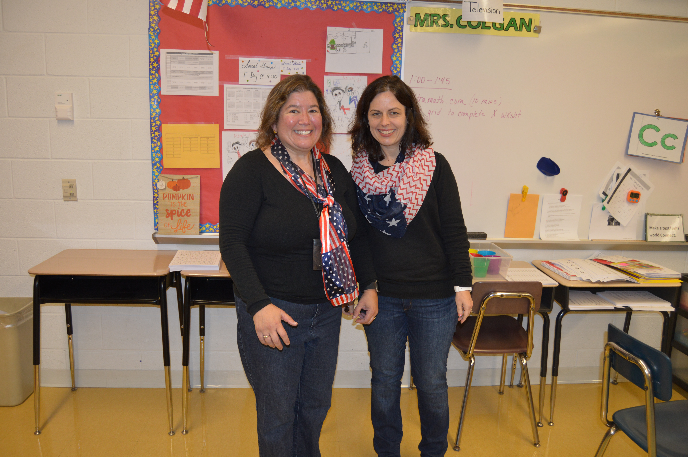
Twin Day

Slide 5
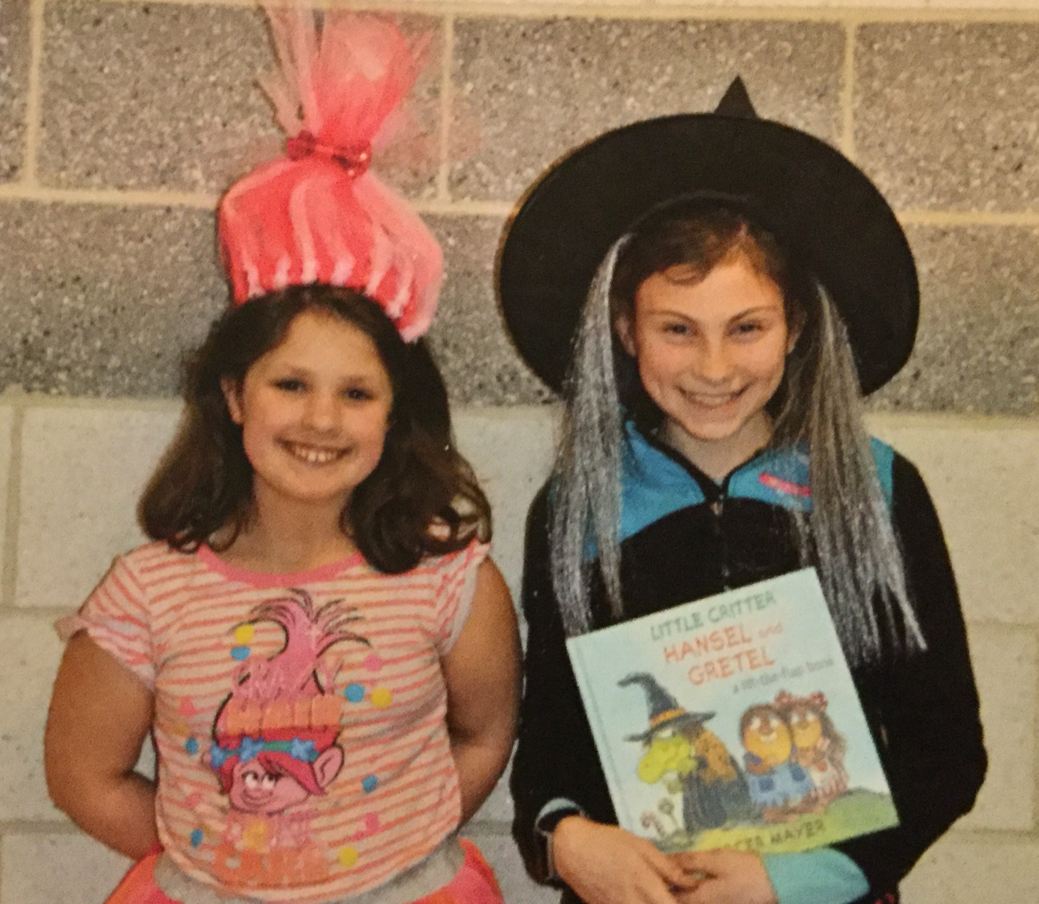
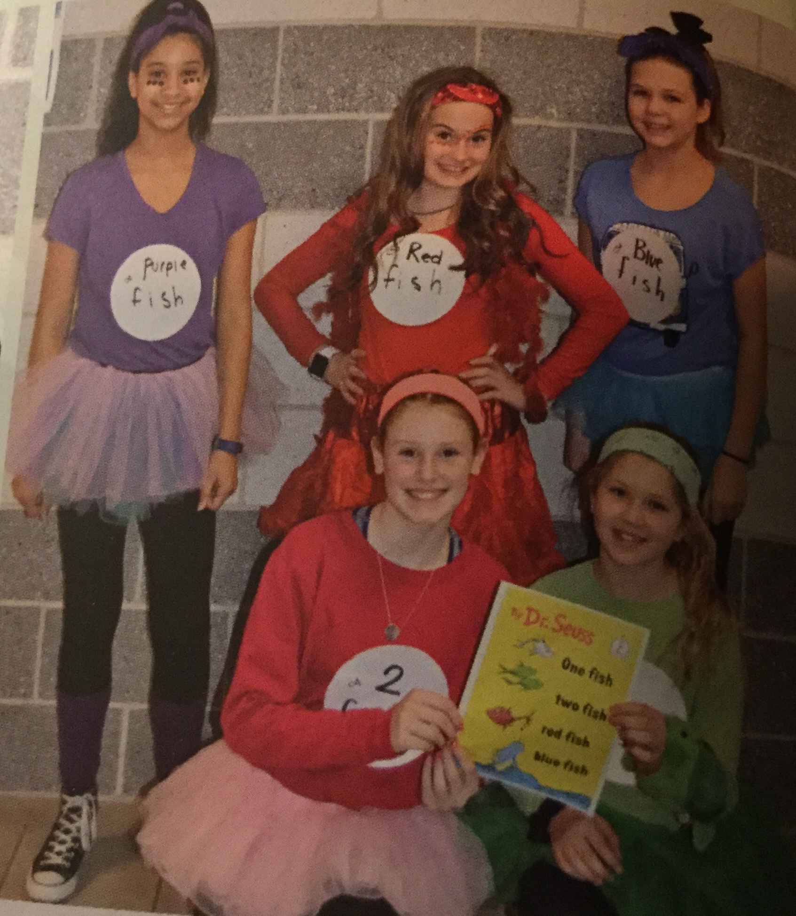
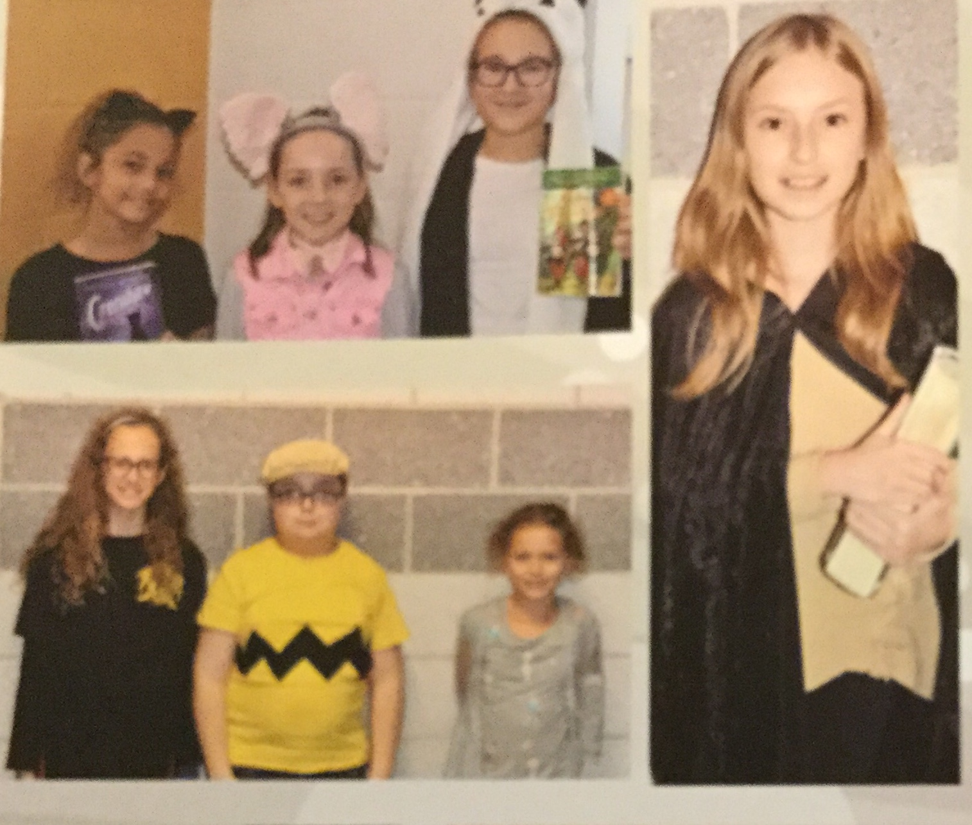
Dress like your favorite book character day

Slide 6
Hopewell School is unique in how our classrooms are set up.
Each classroom is paired with another teacher, which is called a Dyad.
There are some classrooms that include a learning support teacher. This is called a Triad.
5th Grade Teachers 2022-2023
Ms. O’leary /Ms. Kimberling/Mrs.Pierce
Mrs. Midkiff/ Mrs. Gambrell
Mrs. Shahadi/Mrs. Olsen/Mrs. Danilak
Mrs. Hanna/ Mrs. Gollatz/Mrs. Lynch
Mrs. Massimo/ Mrs. Kelleher
Mrs. Gillinger/ Ms. Sauer

Slide 7
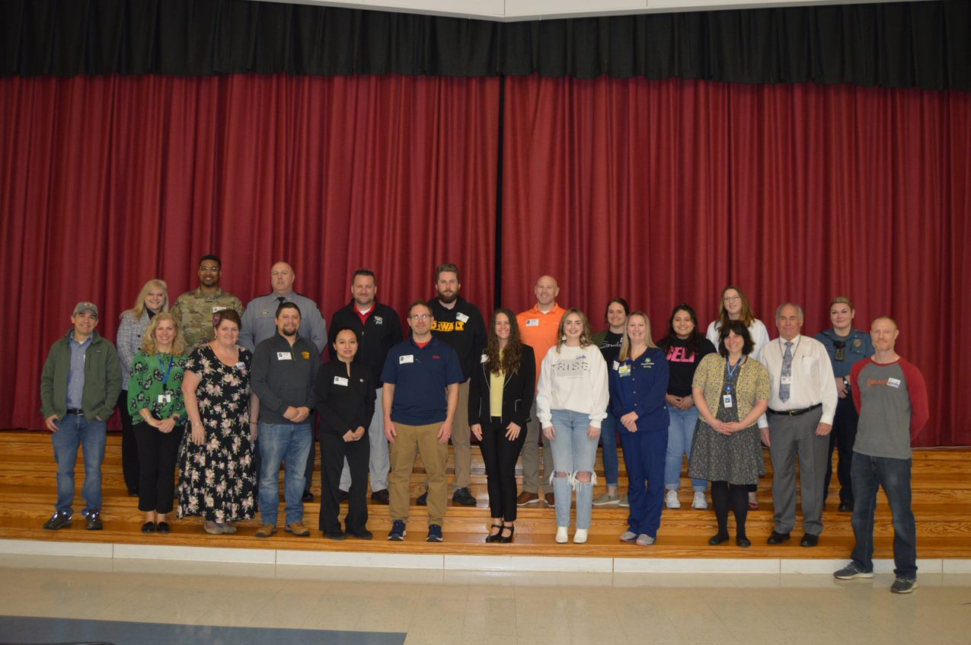
Career Morning Event- Grades 5 & 6
What kinds of Careers interest you?

Slide 8
Career Morning speakers 2023

Slide 9
5th Grade-TCHS Career Café Event

Slide 10
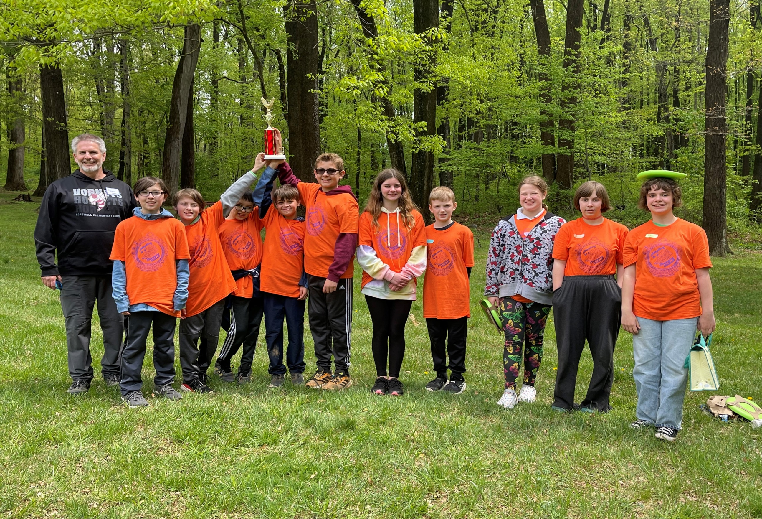
Envirothon / Mr. Barcus

Slide 11
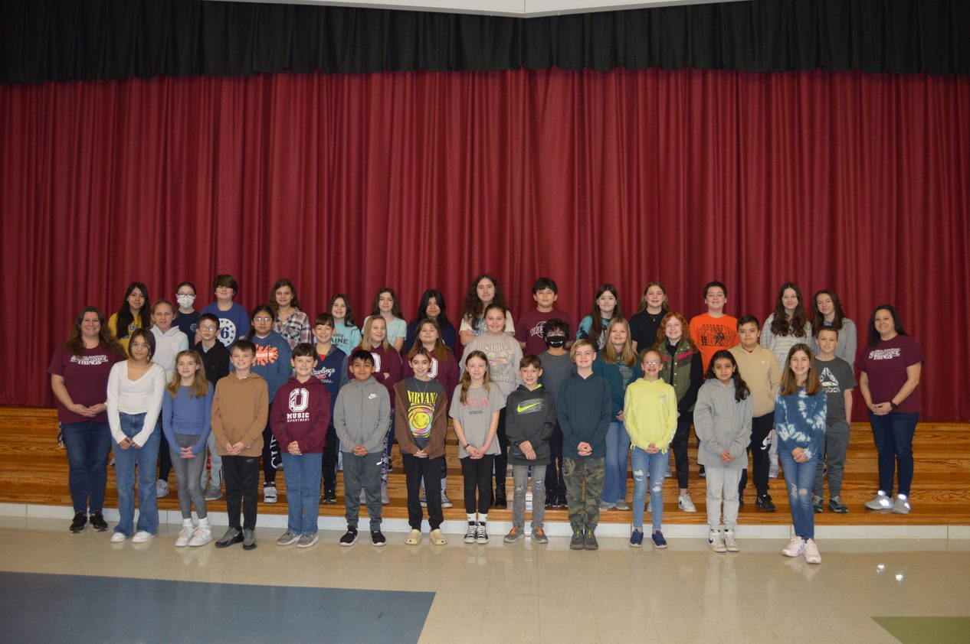
Student Council

Slide 12
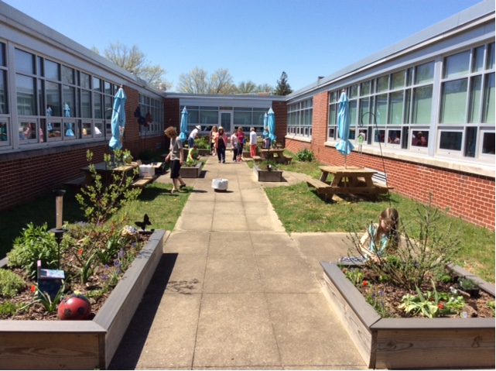
Butterfly Garden

Slide 13
Band & Chorus

Slide 15
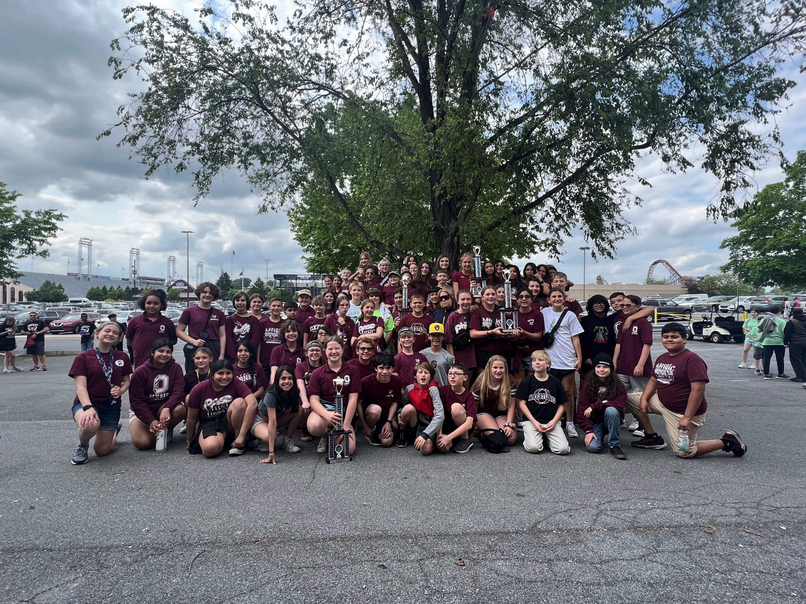
Band at Hershey Park

Slide 16
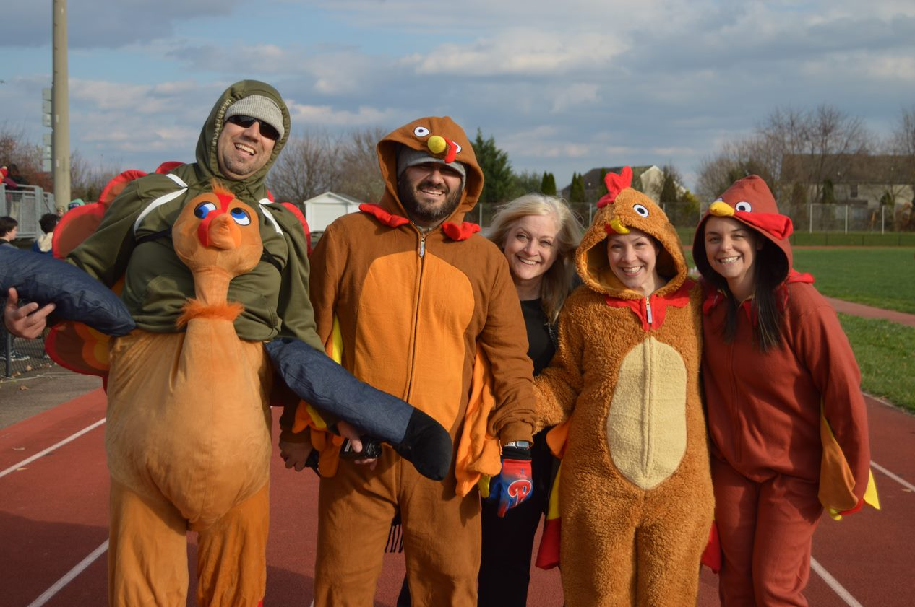
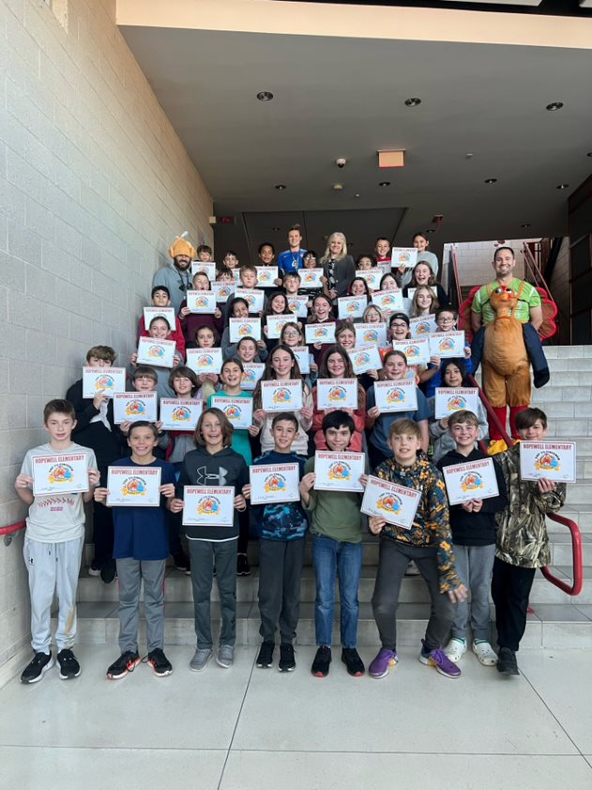
Turkey Trot

Slide 17
Turkey Trot

Slide 18
Special Events: Special Persons Breakfast, Dads & Doughnuts, Moms & Muffins

Slide 19
Summer Reading This information will be posted on the Hopewell webpage in the next few weeks. Have a great summer!!!

Slide 20
Expectations
Each incoming 5th grade student will read 2 books.
Readers will select 1 fiction and 1 nonfiction book from the Summer Reading Project list.
After reading each book, students will choose a project to complete from the list of options.
Projects are due to 5th grade teacher by September 29, 2023.
-
-

Slide 21
Extra Information: Hopewell Website has lots of valuable information posted all summer. Live Well, Learn Well, Hopewell See you in August 2023 @ Meet & Greet

